Slide 1


Resistor
Description and Uses

Slide 2
What is a resistor
A resistor is an electrical component that is designed to have a specific level of resistance to electrical current.
Resistors appear in various sizes but are most commonly available in 1/8 Watt, ¼ Watt, ½ Watt, 1 Watt, and 2 Watt.
A ½ Watt Resistors is on average 9.2 mm in size, while a ¼ Watt resistor is on average 6.3 mm.
Resistors are designed to satisfy Ohm’s Law ( V = I*R) stating that the voltage sent across a resistor must equal the current flow through the resistor
V = voltage across the resistor (in volts)
I = current flow (amps)
R = value of resistor (Ohms)

Slide 3
What Cont.
Resistors are made of a non-conductive core (most commonly ceramics or glass), conductive wiring or metal wrapped around the core (carbon, metal, or metal oxide), and an outside insulation with an axial lead running into either end.
Resistors have a static electrical resistance and are considered “greedy” components or “passive” components, meaning they only consume power and do not create it. They are most commonly placed along with active components in order to limit the voltage input on the component

Slide 4
Resistor Units of Measure
The resistance of these components is measured in Ohms – Ω
1 Ohm is the resistance found when 1 volt pushes 1 ampere of current from point A to point B.
Resistors can be seen measured in Ohms, kilohms, megaohms, and giga-ohms

Slide 5
Types of Resistors
Resistors come in multiple fashions, the most common being carbon-composition resistors. (left)
Carbon-composition resistors are made of graphite hardened alongside clay. The higher the ratio of carbon to clay means the lower the resistance.
Another form is the wirewound resistor. (right)
Wirewound resistors are able to support higher current flow. This makes this type of resistor more effective in DC devices but can inhibit AC devices by causing a sensitivity to change in frequencies.

Slide 6
Types of Resistors Cont.
Resistors can be either through-hole or surface mount. (left)
Through-hole resistors have long axial leads, take up more space, and are more commonly used in prototypes. They are the type of resistor you would expect to see breadboarded.
Surface mount resistors are usually smaller, rectangular shaped components surrounded by conductive edges. (right)
Surface mount resistors are most often tiny and placed onto circuit boards by a robot and soldered in place.

Slide 7
Types of Resistors Cont.
Finally, resistors can be found as either fixed or variable.
Fixed resistors are set to a specific Ohm value and cannot be changed. (left)
Variable resistors (potentiometers) are given a range of Ohm values and can be changed to be a single value within that range (right)

Slide 8
Resistor Uses
Resistors are used to mediate the amount of current transported between components of a circuit or current-system.
Resistors can adjust current flow, divide voltage, terminate transmission, adjust signal levels, and more
They are crucial to circuitry systems by limiting components from drawing too much power, making sure components have enough power, and regulating the total current flow through the system

Slide 9
Issues with Resistors
Resistors must remain under a power threshold so that it does not overheat and cause further damage to both itself and the system.
Power rating is found using the equation P = V*I
The power rating determines the wattage that the resistor can operate at without heat problems. The most common are as stated on slide 2: 1/8 Watt, ¼ Watt, ½ Watt, 1 Watt and 2 Watt, though many can be found at much higher ratings.
The maximum amount of power is based on what the resistor is composed of.
The amount of resistance can change depending on the temperature of the component, called the Temperature Coefficient of Resistance (TCR).
TCR is calculated in parts per million per degree Celsius, with the most common TCR found to be 100 PPM/degree Celsius

Slide 10
Issues with Resistors Cont.
Resistors are always manufactured and placed with a tolerance value in mind.
Tolerance is the amount of variation in the ideal numbers specified by a resistor due to physical components, composition of the resistor, aging, and potential variation in construction.
Resistors are usually marked with a tolerance level, meaning that specific resistor is expected to operate within the specified Ohms plus or minus the resistance level.
A resistor labelled 1.2 Ohms +- 10% will operate between 1.08 Ohms and 1.32 Ohms.
If a tolerance is not given, the most common value is 20%.

Slide 11
Resistor Band Colors
Resistors are marked with colored bands that show the value of the resistor, given the resistor is large enough for markings.
A 4-band color code is used for carbon-composite and metal oxide resistors.
A 5-band color code is used for more accurate metal resistors.
A 6-band color code includes the Temperature Coefficient of Resistance .
Resistor bands are read from left to right, allowing users to understand values and multipliers. A chart of band colors and how to read them is on the next slide.

Slide 12
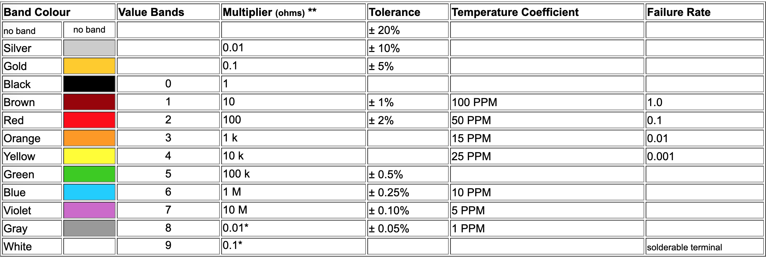
Resistor Band Colors

Slide 13
Sources
https://whatis.techtarget.com/definition/resistor
http://denethor.wlu.ca/pc200/resistance/resistors_fixed.shtml
https://learn.sparkfun.com/tutorials/resistors/all
https://components101.com/articles/resistor-basics-types-and-uses

